Slide 1

TEAM RS

Slide 2
Concept / Scope of solution
The concept and scope of the project is:-
Our aim is to make the 2-wheelers SMART with the help of Artificial Intelligence(AI) and Machine Learning.
Here we have focused on safety and maintenance of Two-wheelers.
The whole system is divided into 3 parts Skid prevention System, tire pressure Check System, Anti theft and Emergency System.
In Skid Prevention system rider is provided with safe leaning angles for efficient driving experience.
tire pressure check system check the pressure of tires and help in maintenance of tire health.
The third System Anti-theft and Emergency system helps in tracking the vehicle.
Emergency button is also provided in the vehicle dashboard that would help the rider in case of accident or mishap and inform the registered mobile nos.

Slide 3
2-Wheelers
AI and ML Modifications
Skid Prevention System
Anti-Theft And Emergency System
tire Pressure Check System

Slide 4
Need Statement
As we know that a lot of accidents happen due to carelessness and improper driving. There are a lot of reasons of a accident and skidding is one of them.
Skidding happens due to excessive leaning/bending while driving, improper way of applying of brakes, while turning at the road banks, etc.
Here we have the system that would detect the lean angle while diving and also provide safe lean angle to avoid skidding.

Slide 5
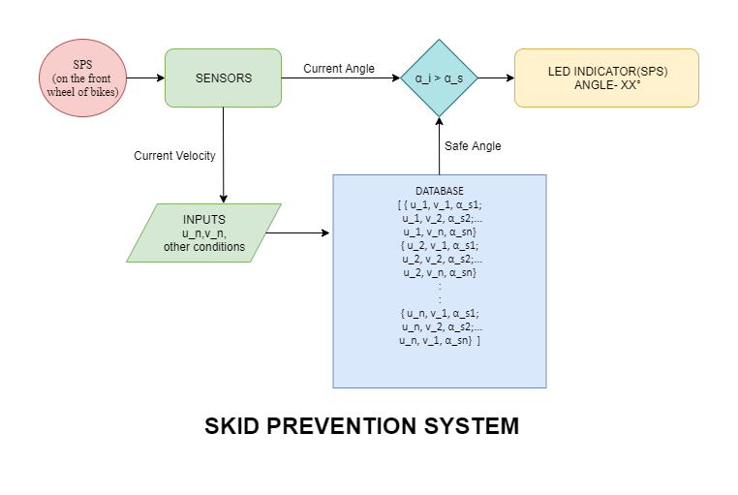

Slide 6
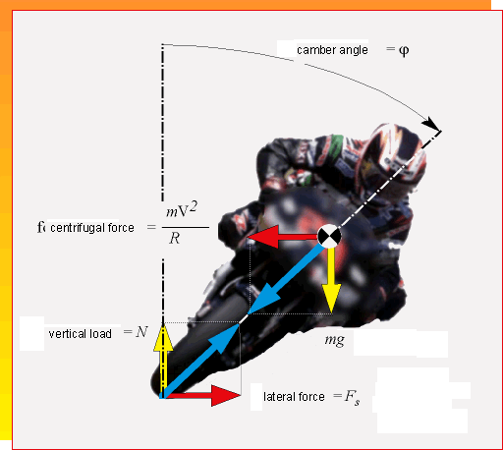
Working
There will be a Device mounted on the front wheel of the 2 wheeler that would calculate the current angle. The calculated angle shall be compared with the safe angle with respect to the speed of the vehicle.
The safe angle shall be predefined for various inputs from the user depending on the road and environmental condition from the database.
Environmental Conditions- the value of friction at different surfaces, the road condition, weather condition, acceleration due to gravity, weight of bike etc.
DATABASE: The database would find the vale of safe w.r.t to the environmental condition, instantaneous velocity of vehicle, etc.
And it would provide a SAFE ANGLE accordingly to the system in order to compare it with instantaneous leaning angle.
If the inclination of the current angle is greater than the safe angle then an LED indicator will glow in order to caution the rider to slow down. Thus preventing a catastrophic accident.

Slide 7
PROS AND CONS
PROS:-
low cost and life saving.
Efficient driving and Safe turnings
Reduce skidding of vehicle and reduce chances of accidents.
Easy installation in existing vehicles.
Great addition in the safety feature chain of the vehicle.
CONS:-
This can’t prevent the rider from accident but act as a prevention measure for smooth riding.
Error may occur due to some environmental conditions. But we can train the system to improve its efficiency.
The sensor may not give the accurate data but we make a rough analysis taking errors under consideration.

Slide 8
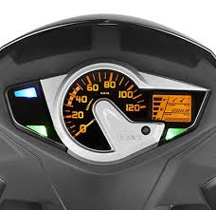

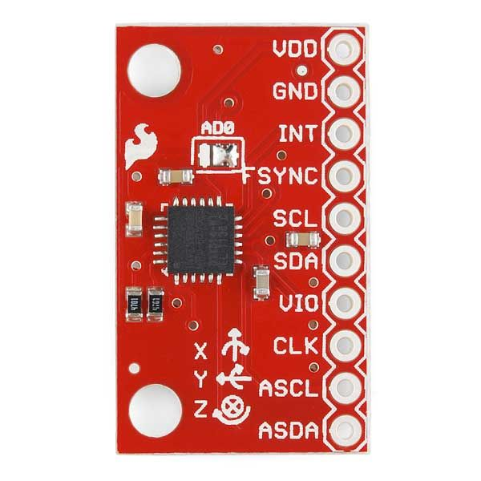

Detailed Description
Arduino Mega microcontroller board based on Atmega2560
LED placed on vehicle Dashboard
16 x 2 bit display provided
On dashboard to show angle
Gyroscope MPU-6050

Slide 9
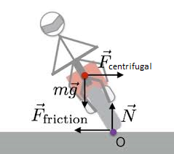

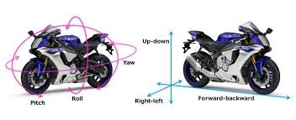
VALIDATION/ ANALYSIS
SPS System on front wheel
GRAPHICAL ANALYSIS OF ANGLE

Slide 10
TIRE PRESSURE CHECK SYSTEM

Slide 11
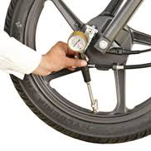
NEED STATEMENT
for smooth riding of vehicle an average tire pressure should be maintained.
Average tire pressure of
Bikes: Front Tire- 30psi and Rear Tire-40psi
As per recommended by the manufacturer.
Currently we use manual method to check the air pressure of the tire.
Our aim is to acknowledge the user about the tire pressure so that he/she can take proper maintenance of vehicle.
Low pressure in tire can cause decrease in the fuel efficiency, vehicle pickup , etc.
Minor leakages and small punctures can be determined.

Slide 12
WORKING MECHANISM
The nozzle of the tires are modified so that pressure of the tire can be monitored and a low pressure or a minor puncture in the vehicle can be detected and displayed on the dashboard via an indicator light.
This is done by taking pressure input and comparing it with a threshold.
The modified valve would contain a Led light. If the tire pressure is below threshold then it would glow indicating low pressure.
FUTURE ASPECTS:
According to the usage of the vehicle an AI system can also display the average repressuring time of the tires of the vehicle according to the usage of vehicle.

Slide 13
PROS AND CONS
PROS
By helping in maintaining proper tire pressure ,device can increase the safety on roads by improving vehicle handling, decreasing tire wear, reducing braking distance and bettering fuel economy.
Minor leakages and small punctures can be determined.
Easy installation on existing vehicle.
Low cost
CONS
Some times may fail due to external factors. But while manufacturing utmost care will taken for its durability.

Slide 14
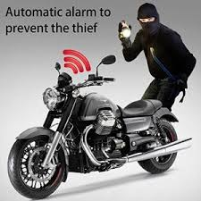
Anti Theft and Emergency Detection System

Slide 15
Need for anti-theft system in bikes
The need for an antitheft device in bikes is indispensable in a country like India with such geographical diversity. We not only need to protect our bikes from the various ill elements present in our society but also see to it that if such a mishap occurs, our bike can be tracked with ease.
So a full fledged anti-theft device is of utmost necessity. So that not only can the vehicle be protected but also tracked.
Emergency detection device would help the rider in case of emergency, accident, etc. This system can help the rider to inform his friends or relatives in case of any mishap.
The system helps to inform the rider’s friends and relatives.

Slide 16
WORKING OF THE SYSTEM
The anti theft and emergency detection system
Let us assume three cases what a thief might do while stealing a bike
First, he will try to unlock the handle
Next, he will put on ignition
And lastly he will ride the bike i.e. Change the location of vehicle.
Now covering all the three cases the antitheft and emergency system is designed.
Whenever the handle unlocked or the engine is started, the device will send a message to the registered owner’s mobile number. And finally the location of the bike can be sent to the same number.
The introduction of the EMERGENCY BUTTON is also an added boon.
Imagine a situation where the rider faces a problem or meets with an accident and the people around him cannot access his family in this case if some one presses the emergency button, the location of the bike along with a message will be sent to the mobile number kept as emergency number.

Slide 17
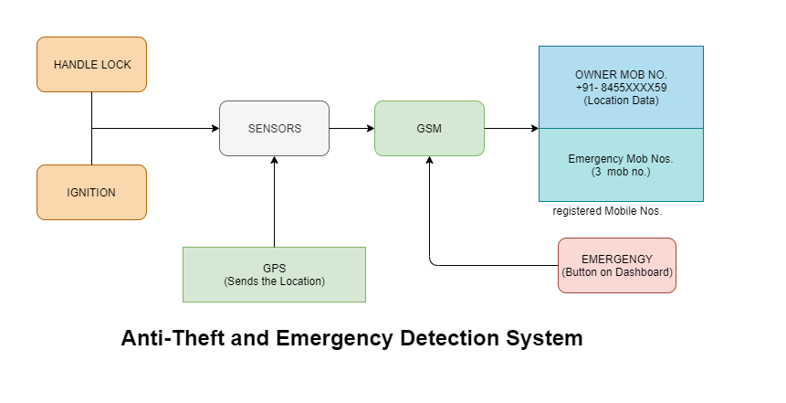

Slide 18
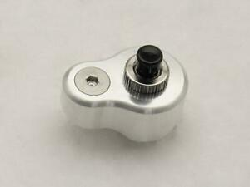
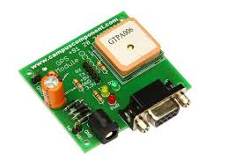


TIRE PRESSURE CHECK SYSTEM
Arduino Mega microcontroller board based on Atmega2560
Emergency button for uncertain mishaps
GPS AND GSM MODULES(for sending and receiving location and data )
Messages Send to reg. mobile nos.

Slide 19
Working Mechanism
The system should be installed during manufacturing.
GPS module installed in the bike it will give the location of the bike and that location will be sent to owner’s mobile via a message.
GSM module would send a message to the user when the handle lock is opened and also when the bike is started.
Messages of location is sent to the registered mobile numbers .As our mobile data is backed up in our drive our vehicle location data is also stored.
An emergency switch is also provided in bike dashboard that would inform the rider’s relative in case of emergency or accident.

Slide 20
Advantages over conventional methods
This system not only prevents the theft from happening but also takes the worst case condition and sends the location to the owner, controls mishaps in case of emergency.
Low cost and can be easily installed in existing technology.
Security of vehicle is increased.
Emergency Alert Switch.
Such a device has an added advantage over the conventional methods as it is preinstalled in the bike and cannot be removed.

Slide 21
Results and potential Business Impact
Our cases are speciﬁcally designed with features suiting HERO MOTO Corp. :
The product range: The product is useful in any automobile(2 wheelers) and implementing new technology in automobile industry for consumers at an affordable price.
Minimized threat: Our product is durable, low cost. Thus, this product has no signiﬁcant potential to cause any harm to the operator.
Minimum outage period: The parts used are not likely to fail. But even if these do, the replacements of every part is of least cost. The product has low maintenance but must be regularly checked.
Least business risk: The product has design and economic advantage over every other product currently in the market providing accurate and reliable results. Also it can help in increasing the market of Hero Moto Corp.
Workaround procedures: Our product is user friendly with has easy interface.

Slide 22
THANK YOU

